Slide 1
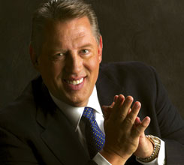

Slide 2
Influence
Vision
Change
People
Attitude
Integrity
Development

Slide 3
Influence

Slide 4
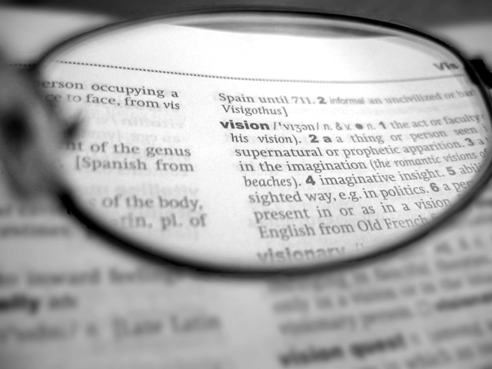
Vision

Slide 9
Development

