Slide 1
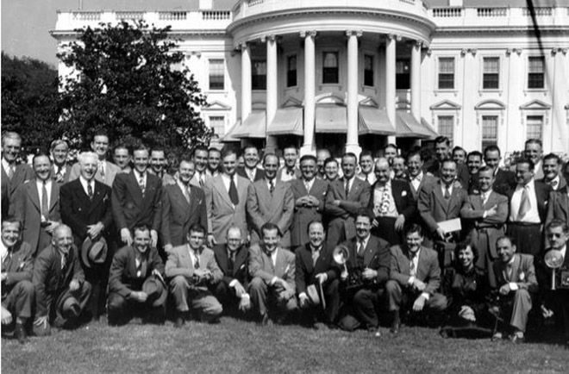
Helen Thomas
&
The White House Press Corps

Slide 2
What is the WH press corps?
    The White House Press Corps is a group of journalists whose job it is to cover White House news and events, report on the president and news briefings.
    The press secretary holds daily briefings with the members of the press corps.
    Jay Carney is the current press secretary

Slide 3
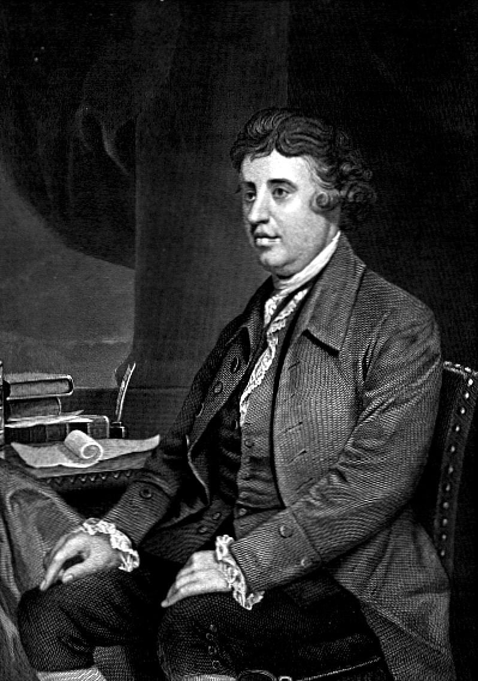
Why do we have a press corps?
“There are three estates in Parliament, but in the Reporters Gallery there sits a fourth estate more important far than all.”
Edmund Burke, politician/ philosopher

Slide 4
Why do we have a press corps?
  Plays an important role in informing the populace
  Helps the administration reach the public directly
  Provides clear explanation of complicated legislation

Slide 5
White House Correspondents Association
    Founded in 1914
    “shall be the promotion of the interests of those reporters and correspondents assigned to cover the White House.”
    Organizers of the Correspondents dinner

Slide 6
Problems with women
  President Kennedy was the first president to insist that women be allowed into the Correspondents Dinner
  This was at the instance of Helen Thomas
  Which brings us nicely to…

Slide 7
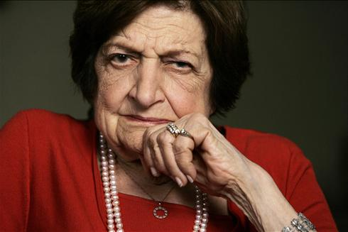
Helen Thomas

Slide 8
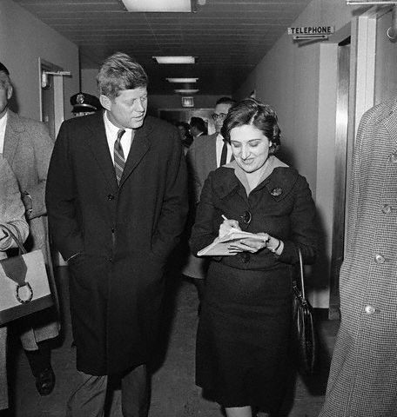
Early life
Born in Kentucky, raised in Detroit, Michigan to Lebanese parents.
First job at Washington Daily News as a copygirl.
Moved to United Press
(later UPI) as a columnist

Slide 9
Successes in women’s rights
Women’s National Press Club Khrushchev briefing
First female member (and later president) of WHCA
A fixture in American political journalism
“Thank you Mr. President.”

Slide 10
Leadership
Questioning style-Blunt, to the point, for the people
Broken barriers for women
Leads by example
Outspoken and independent

Slide 11
